Slide 1

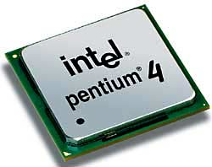
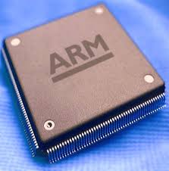
Microprocessor & Computer Architecture UE17CS253
UNIT-4
Session – 1
Interrupts & Interrupt Handling Mechanism

Slide 2
SOFTWARE METHOD – POLLING
In this method, all interrupts are serviced by branching to the same service program.
This program then checks with each device if it is the one generating the interrupt.
The order of checking is determined by the priority that has to be set.
The device having the highest priority is checked first and then devices are checked in descending order of priority.
If the device is checked to be generating the interrupt, another service program is called which works specifically for that particular device.
The structure will look something like this-
if (device[0].flag) device[0].service();
else if (device[1].flag) device[1].service();
. . . . . .
else //raise error

Slide 3
HARDWARE METHOD – DAISY CHAIN
The daisy-chaining method involves connecting all the devices that can
request an interrupt in a serial manner.
This configuration is governed by the priority of the devices.
The device with the highest priority is placed first followed by the
second highest priority device and so on.

Slide 4



What is Interrupt/Exception?
Main ()
{
:
Doing something
(e.g.
browsing)
:
} ring
Phone rings
Can happen anytime
Depends on types of interrupts
Phone rings
_isr() // Interrupt service routine
{
some tasks (e.g. answer
telephone)
} //when finished,
//goes back to main

Slide 5
Interrupts
Interrupts
Reset
(or power up)
Software
Interrupt
SWI-XX
Hardware
Interrupt
FIQ,IRQ
Timer
ADC
External
Interrupt
EINT
Triggered by the software instruction SWI x
Triggered by hardware sources
Triggered by power_up/
reset_key

Slide 6
Interrupt and Exception
The terms are used differently by various manufacturers
Traditionally exception means
The normal operation of a program is interrupted and the processor will execute another piece of software (exception handling) somewhere.
Interrupt (hardware interrupt) is an exception caused by some hardware condition happening outside the processor (e.g. external hard interrupt, IRQ FIQ).
Software interrupt (SWI) is an exception caused by an assembly software instruction (SWI 0x?? exception call instruction) written in the software code.
Trap is an exception caused by a failure condition of the processor (e.g. abort “pre-fetch , data” , undefined instruction, divided_by_zero, or stack overflow etc)

Slide 7
Important Interrupts in words
Reset, a special interrupt to start the system– happens at power up , or reset button depressed)
Software interrupt SWI :
Similar to subroutine – happens when “SWI 0x??”
is written in the program
Hardware interrupt
FIQ (fast interrupt) or IRQ (external interrupt), when
the external interrupt request pin is pulled low, or
an analogue to digital conversion is completed, or
A timer/counter has made a regular request

Slide 8
Compare hardware and software interrupt
Hardware interrupt, e.g.
Software interrupt
IRQ_Eint1()
{
::
}
A falling edge at EINT3 will trigger the
execution of the interrupt service routine
__irq IRQ_Eint1()
Computer
EINT3
Computer
Main{
:
SWI N
:
}
An instruction “SWI N” in
the program will trigger the
execution of
the N-th-sys-routine
(system routine)
N-th-sys-routine()
{
::
}

Slide 9
Exception (interrupt) Modes
ARM supports 7 types of exceptions and has a privileged processor mode for each type of exception.
ARM Exception (interrupt) vectors
Interrupt Vector Table

Slide 10
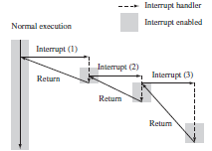
Exception (interrupt) Modes
Nested Interrupt call
Interrupt Service Routine
Status Registers
Saving register contents on to the stack.
Restore while return to the interrupted program.

Slide 11
The second method involves prioritization.
You program the interrupt controller to ignore interrupts of the same or lower priority than the interrupt you are handling, so only a higher-priority task can interrupt your handler.
You then re-enable interrupts. The processor spends time in the lower-priority interrupts until a higher-priority interrupt occurs.
Therefore higher-priority interrupts have a lower average interrupt latency than the lower-priority interrupts, which reduces latency by speeding up the completion time on the critical time-sensitive interrupts.

Slide 12
IRQ and FIQ Exceptions
IRQ and FIQ exceptions only occur when a specific interrupt mask is cleared in the cpsr
An IRQ or FIQ exception causes the processor hardware to go through a standard procedure (provided the interrupts are not masked):

Slide 13
1. The processor changes to a specific interrupt request mode, which reflects the interrupt being raised.
2. The previous mode’s cpsr is saved into the spsr of the new interrupt request mode.
3. The pc is saved in the lr of the new interrupt request mode.
4. Interrupt/s are disabled—either the IRQ or both IRQ and FIQ exceptions are disabled in the cpsr. This immediately stops another interrupt request of the same type being raised.
5. The processor branches to a specific entry in the vector table.

Slide 14
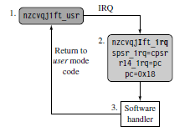
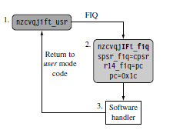

Slide 15
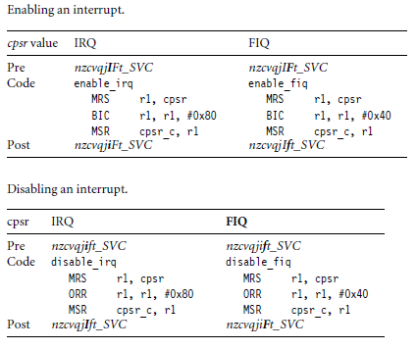
Enabling and Disabling FIQ and IRQ Exceptions

Slide 16
Basic Interrupt Stack Design and Implementation
Exceptions handlers make extensive use of stacks, with each mode having a dedicated register containing the stack pointer. The design of the exception stacks depends upon these factors:
■ Operating system requirements—Each operating system has its own requirements for
stack design.
■ Target hardware—The target hardware provides a physical limit to the size and positioning of the stack in memory.

Slide 17
Two design decisions need to be made for the stacks:
■ The location determines where in the memory map the stack begins. Most ARM-based systems are designed with a stack that descends downwards, with the top of the stack at a high memory address.
■ Stack size depends upon the type of handler, nested or non nested. A nested interrupt handler requires more memory space since the stack will grow with the number of nested interrupts.

Slide 18
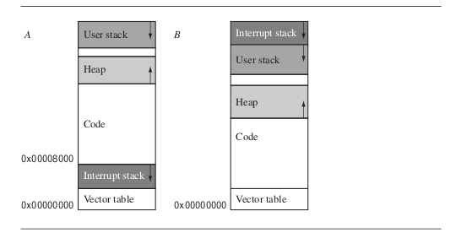
Basic Interrupt Stack Design and Implementation
Stack Layouts

Slide 19
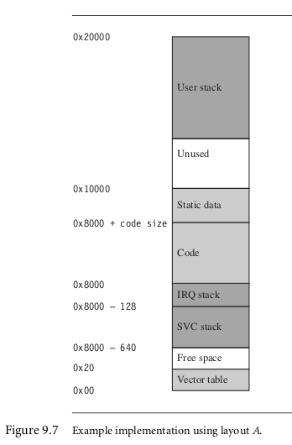
Basic Interrupt Stack Design and Implementation

Slide 20
Interrupt Handling Schemes
Non-Nested Interrupt Handler
Nested Interrupt Handler
Re-Entrant Interrupt Handler
Prioritized Simple Interrupt Handler
Prioritzied Standard Interrupt Handler
Prioritized Direct Interrupt Handler
Prioritized Grouped Interrupt Handler
VIC PL190 based ISR

Slide 21
Interrupt Handling Schemes Non-Nested Interrupt Handler
Simplest:
Interrupts are disabled till control is returned back to program which was being executed
Services single Interrupts at a time
Not suitable for complex embedded systems

Slide 22
Interrupt Handling Schemes Non-Nested Interrupt Handler
Various stages in a NNIH –
Disable Interrupts
IRQ raised → Interrupts disabled, no further Interrupts → processor mode changed → cpsr saved in spsr_{interrupt request mode} →pc is saved → pc points to VT → VT points to Interrupt handler
Save context
Handler saves a subset of non-banked registers

Slide 23
Interrupt Handling Schemes Non-Nested Interrupt Handler
Various stages in a NNIH –
Interrupt Handler
Handler identifies interrupt source and executes appropriate ISR
Interrupt Service Routine
ISR Services the interrupt source and resets the interrupt
Restore Context
ISR returns back to handler which restores the saved context

Slide 24

Interrupt Handling Schemes Non-Nested Interrupt Handler
Various stages in a NNIH –
Enable Interrupts
spsr ← spsr_{interrupt request mode}
pc is restored

Slide 25
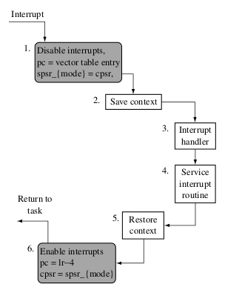
Interrupt Handling Schemes Non-Nested Interrupt Handler

Slide 26
Priority Interrupts
A priority interrupt is a system which decides the priority at which various devices, which generates the interrupt signal at the same time, will be serviced by the CPU.
The system has authority to decide which conditions are allowed to interrupt the CPU, while some other interrupt is being serviced.
Generally, devices with high speed transfer such as magnetic disks are given high priority and slow devices such as keyboards are given low priority.
When two or more devices interrupt the computer simultaneously, the computer services the device with the higher priority first.

Slide 27
Programmable Interrupt Controller
8 levels of Interrupts
Can be cascaded in master- slave configuration to handle 64 levels of interrupts.
Internal Priority Resolver
Fixed Priority Mode & Rotating Priority Mode
Individually Maskable Interrupts
Modes and masks can be changed dynamically
Accepts IRQ, determines priority, checks whether incoming priority current level being serviced, issues interrupt signal.
Polled and vectored mode
Starting address of ISR or Vectored number is programmable.

Slide 28
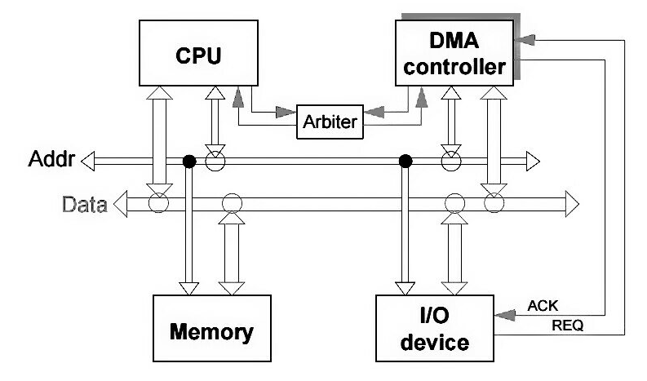
Direct Memory Access(DMA) Controller
What is actually DMA?
The direct memory access is a system where the samples are saved in the memory of the system while the processor does something else.
Why we need DMA?
The assumption about the I/O machines like keyboards, mouse, and printer etc. are genuinely very slow when compared with the central processing unit (CPU).
To overcome this issue an interrupt handler was used and the I/O machine produces all the signals that the CPU produce, then the I/O machine can bypass the information alienates to central processing unit and hence increases the speed.

Slide 29
Direct Memory Access(DMA) Controller
Cycle Stealing Process: Traditionally it is a method of accessing RAM or bus without interfering with the CPU.
DMA allows I/O controllers to read or write RAM without CPU intervention.
Clever exploitation of specific CPU or bus timings can permit the CPU to run at full speed without any delay if external devices access memory not actively participating in the CPU's current activity and complete the operations before any possible CPU conflict.
Such systems are nearly dual-port RAM without the expense of high speed RAM.
Most systems halt the CPU during the steal, essentially making it a form of DMA by another name

Slide 30
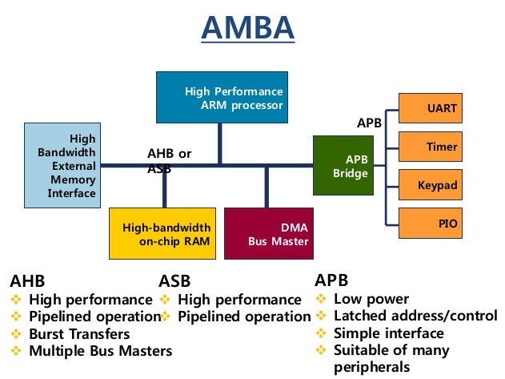
AMBA (Advanced Microprocessor Bus Architecture) protocol
The Arm AMBA protocols are an open standard, on-chip interconnect specification for the connection and management of functional blocks in a System-on-Chip (SoC).
It facilitates right-first-time development of multi-processor designs with large numbers of controllers and peripherals.
Features of AMBA Interfaces:
IP reuse is essential in reducing SoC development costs and timescales. AMBA specifications provide interface standards that enables IP reuse if the following essential requirements are met:
Flexibility:
Wide Adaption:
Compatibility:
Support:

Slide 31
APB (Advanced Peripheral Bus ) protocol
The Advanced Peripheral Bus (APB) is part of the Advanced Microcontroller Bus Architecture (AMBA) protocol family.
It defines a low-cost interface that is optimized for minimal power consumption and reduced interface complexity.
The APB protocol is not pipelined, use it to connect to low-bandwidth peripherals that do not require the high performance of the AXI protocol.
The APB protocol relates a signal transition to the rising edge of the clock, to simplify the integration of APB peripherals into any design flow.
Every transfer takes at least two cycles.
The APB can interface with:
• AMBA Advanced High-performance Bus (AHB)
• AMBA Advanced High-performance Bus Lite (AHB-Lite)
• AMBA Advanced Extensible Interface (AXI)
• AMBA Advanced Extensible Interface Lite (AXI4-Lite)

Slide 32
Q & A on Interrupts , Interrupt Handling Mechanism PIC & DMA Controller

